Slide 1

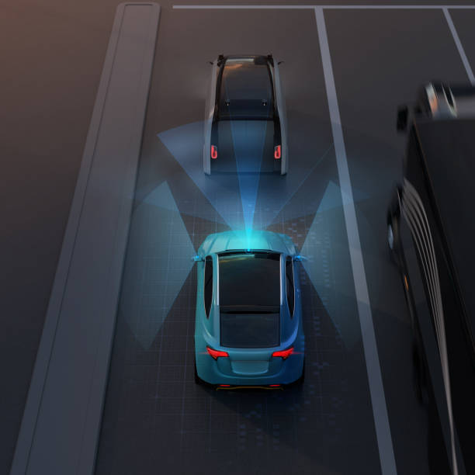
Autonomous Emergency Braking system
TEAM – 3
Mohamed Asharaf.N
Shivani.B
Giriprasath.M.U
Sivaranjani.P
Harinivash.K

Slide 2
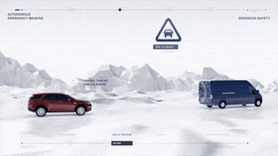
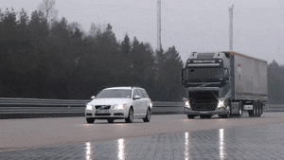
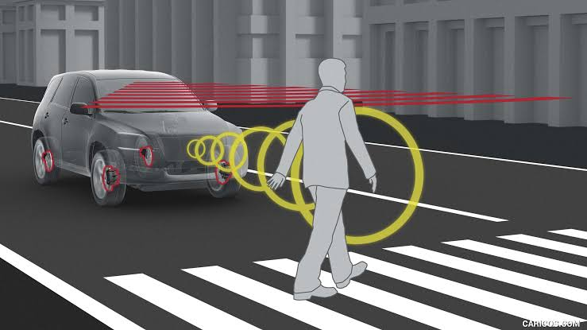
AEB - Working
Autonomous emergency braking system follows the function of applying brakes automatically when there is any collision or probability of hitting an moving or stable vehicle or pedestrian .
The system detects obstacles (pedestrians, vehicles, etc.) and automatically applies the brakes or increases the braking force if the driver is applying the brakes insufficiently.
Fig1
Fig2
Fig3

Slide 3

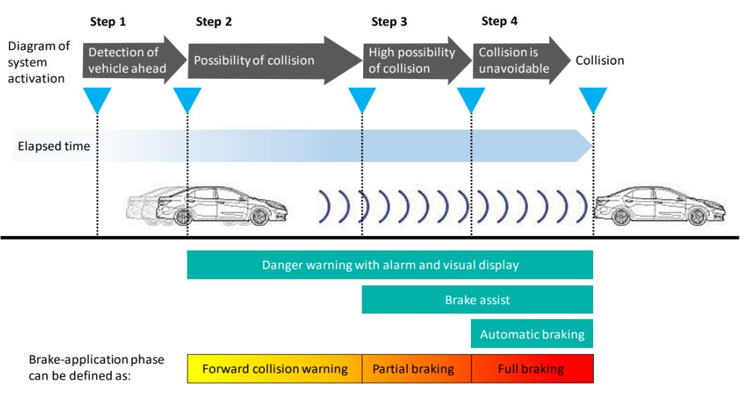
AEB Phases
source
Target

Slide 4
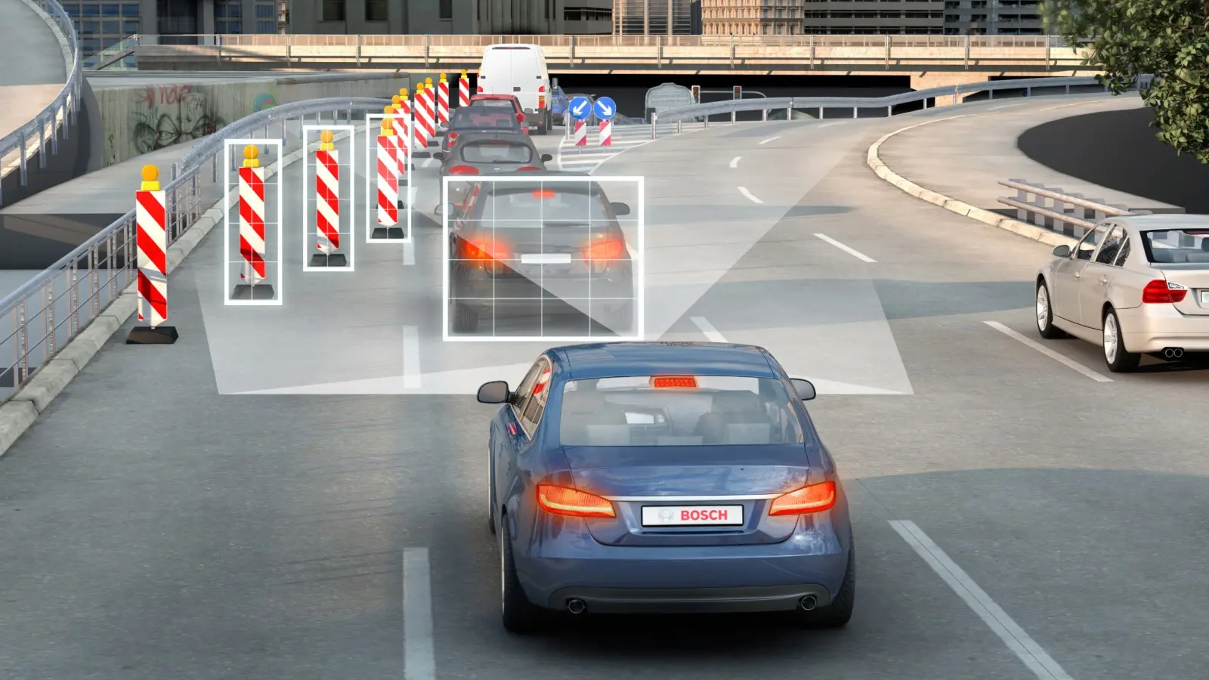
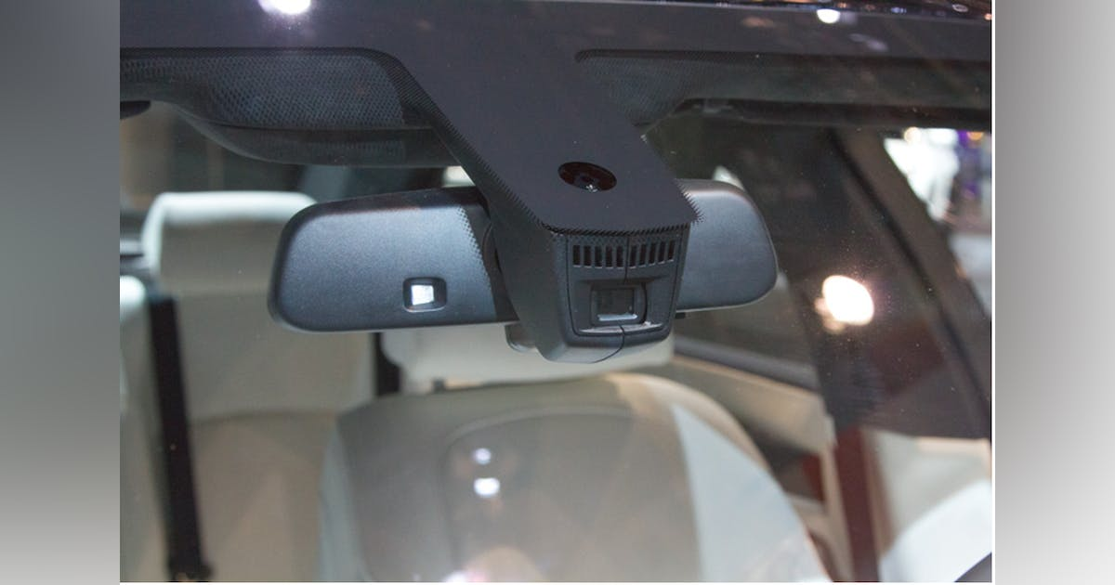
EMERGENCY BRAKING USING CAMERA STEREO DETECTION

Slide 5
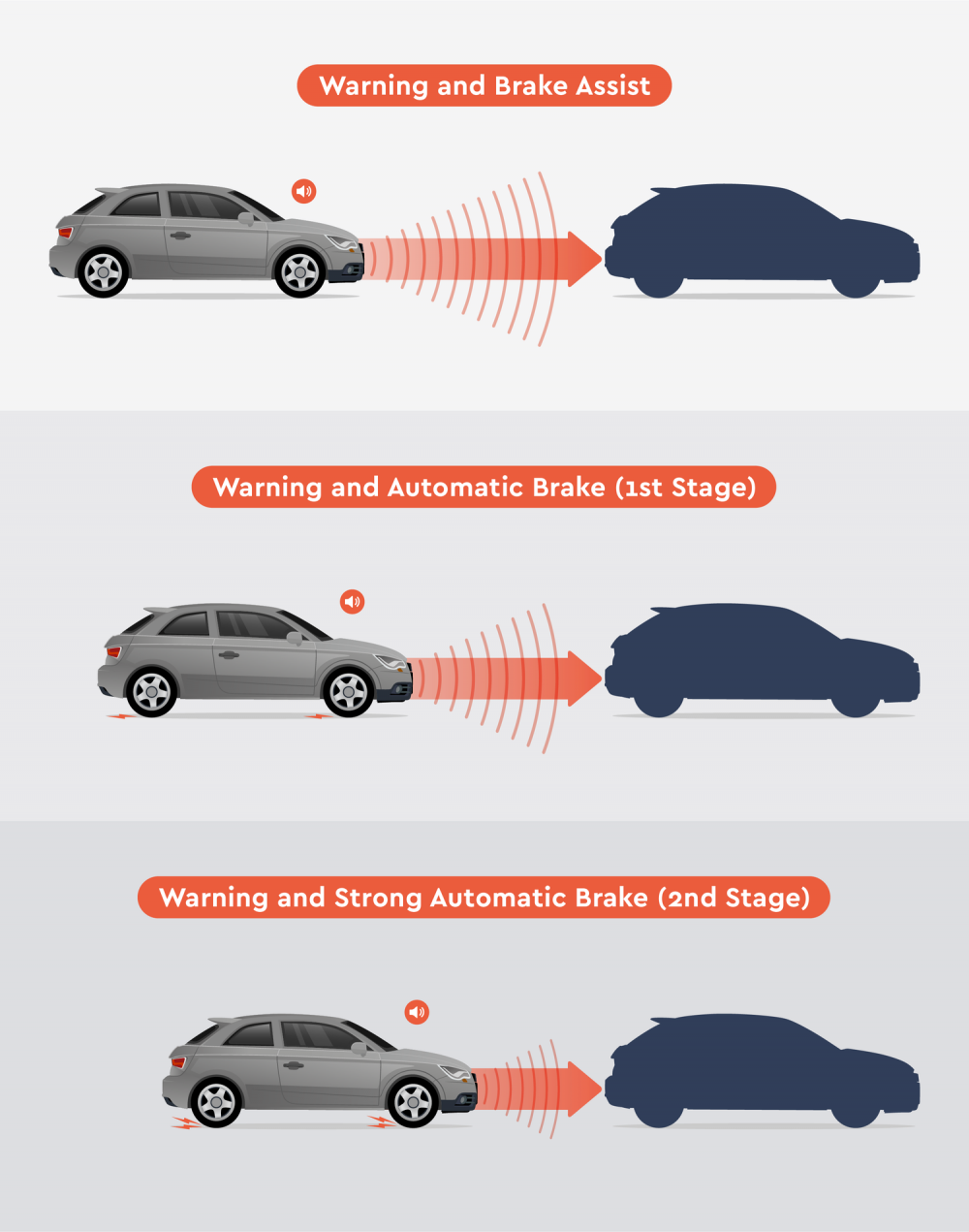
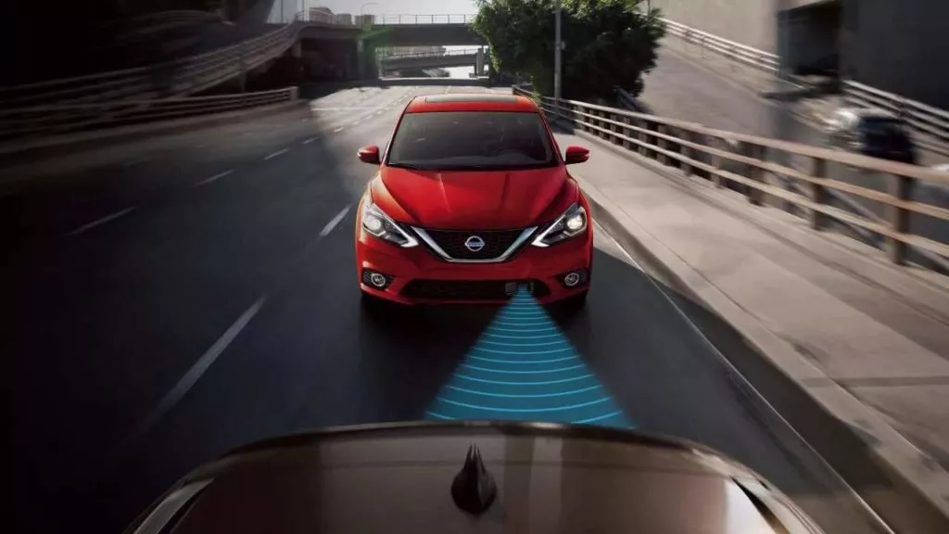
EMERGENCY BRAKING USING RADAR

Slide 6
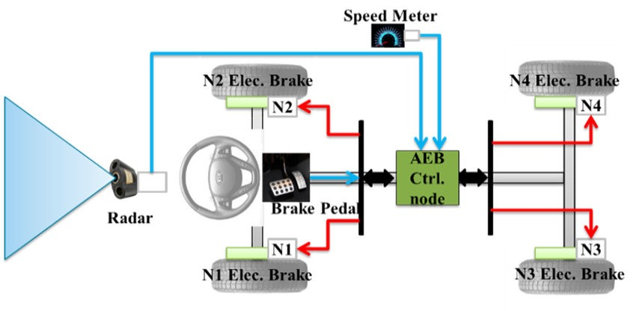
PROCESS OF BRAKING SYSTEM

Slide 7

FORMULAS
Speed (velocity) of the ego vehicle, the change in distance between the ego vehicle and the leading vehicle data's are collected as physical values.
Relative velocity = V2 – V1
TTC = Distance / Relative velocity
Deceleration = Mass of the vehicle / Braking Force
Braking force = 0.5* Mass of the vehicle * initial speed^2 / Distance to avoid collision
Psi of the brake fluid = (pedal ratio * pedal force applied) / master cylinder bore size
Clamping force = 2 * π * psi of brake fluid into the callipers
Brake force = 2 * clamping force * coefficient of friction.
Final velocity V = initial velocity + (deceleration * time)
Distance = (initial velocity * time) + ½ (deceleration * time^2)

Slide 8
BLOCK DIAGRAM
IMPACT FACTORS
DRIVERS ACCELERATION
DRIVERS BRAKING FORCE
INPUTS
EXECUTION
DECISION MAKING
EARLY WARNING
SENSORS INFORMATION
RELATIVE VELOCITY
TIME TO COLLISION
DECELERATION
BRAKING FORCE
BRAKING
EGO VEHICLES INFORMATION

Slide 9
INPUTS
Speed of the ego vehicle
Mass of the vehicle
Speed of the leading vehicle
Distance between two vehicles
Time to collision
Brake force
Braking deceleration
Brake pedal pressure
Stopping time, stopping distance
OUTPUT
FCW indication
Partial braking and PB indication
Full braking and FB indication

Slide 10
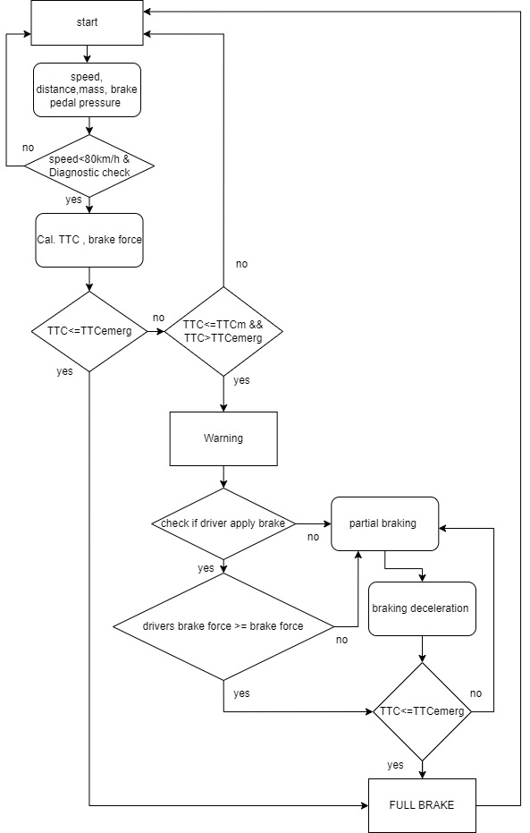
FLOW DIAGRAM

Slide 11
FUNCTIONAL REQUIREMENTS
FR1: To get the speed of the ego vehicle and leading vehicle and distance between them.
FR2: Check if the speed of the ego vehicle is less than 80 Km/hr. If the condition is false, then AEB should not be turned on
FR3: If the above condition is true then calculate the time to collision.
FR4: If TTC<TTCemerg, then AEB should activate the warning and full braking by calculating the required braking deceleration.
FR5: If the above condition fails then check TTC<=TTCm and TTC>TTCemerg. If this condition fails, then AEB will not be active.
FR6: If the FR5 is true then AEB should activate the FCW warning.
FR7: Then check if the driver applies brakes within the reaction time. Then check the drivers brake force >= required brake force. If the conditions is satisfied then AEB should not be active.
FR8: If the driver does not take any action. Then it will go to the partial braking phase and again check the TTC<=TTCemerg . if it is satisfied then go to full braking else move to partial braking
FR9: If the driver brake force < partial braking force then it will move to the partial braking phase and check the TTC<= TTCemerg . if it is satisfied then go to full braking else move to partial braking

Slide 12
DIAGNOSTIC CHECKS
If the AEB system is not functioning properly, it is recommended to inspect and diagnosed, it may result in several errors or malfunctions include
Sensor damage or sensor failure
Calibration issue
Brakes Malfunctioning
Brake pedal sensor failure
Solenoid valve failure

Slide 13


THANK YOU

